Slide 1

Universal Optimality of Dijkstra
via Beyond-Worst-Case Heaps
Part 1 Universally optimal Dijkstra
Bernhard Haeupler, Richard Hladık, Vaclav Rozhon, Robert E. Tarjan, Jakub Tetek
Presented by Ao-qi Song
Date: 2024-11-26

Slide 2



Authors
Bernhard Haeupler
Faculty, INSAIT, Sofia University
Post-Prof. & Researcher, ETH Zurich, Computer Science Department
Adjunct Prof., Carnegie Mellon University, Computer Science Department
Robert Tarjan
James S. McDonnell Distinguished University Professor of Computer Science, Princeton University
Received the Turing Award in 1986 for his work on graph algorithms and data structures
1

Slide 3
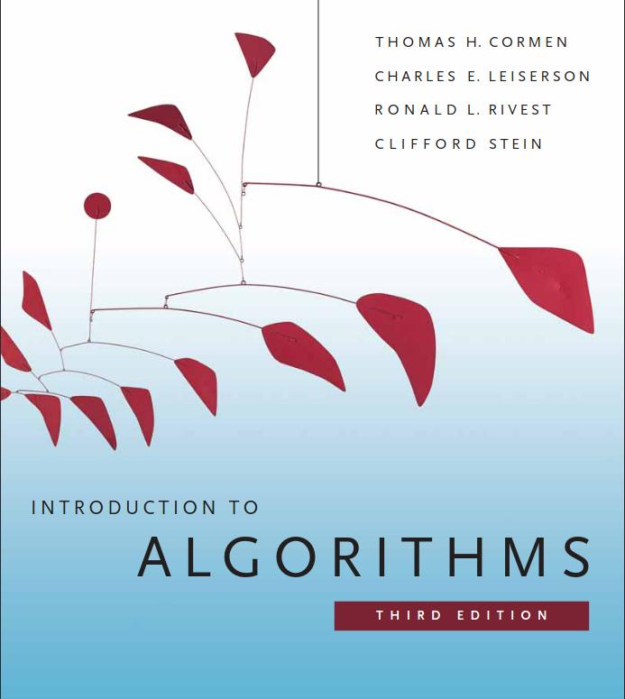
Reference
Introduction to Algorithms (Third Edition & Thorth Edition)
Thomas H. Cormen, Charles E. Leiserson, Ronald L. Rivest, Clifford Stein
2

Slide 4
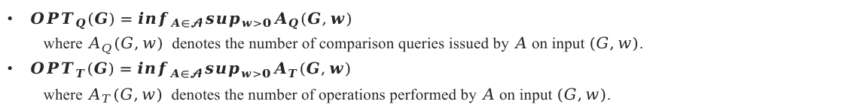
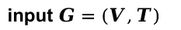
Overview
Lemma E.1.
${OPT}_{Q}(G)+m+n=Ο({OPT}_{T}(G))$
input $G=(V,T)$
Definition
${OPT}_{Q}(G)=\inf_{A∈𝓐}\sup_{w>0}A_{Q}(G,w)$
where $A_{Q}(G,w)$ denotes the number of comparison queries issued by $A$ on input $(G,w)$.
${OPT}_{T}(G)=\inf_{A∈𝓐}\sup_{w>0}A_{T}(G,w)$
where $A_{T}(G,w)$ denotes the number of operations performed by $A$ on input $(G,w)$.
Theorem 3.1
Dijkstra’s algorithm implemented using any Fibonacci-like priority queue with the working set property has time complexity $O({OPT}_{Q} (G)+m+n).$
data structure
Haeupler, Bernhard, et al. "Universal Optimality of Dijkstra via Beyond-Worst-Case Heaps." arxiv preprint arxiv:2311.11793.
3

Slide 5
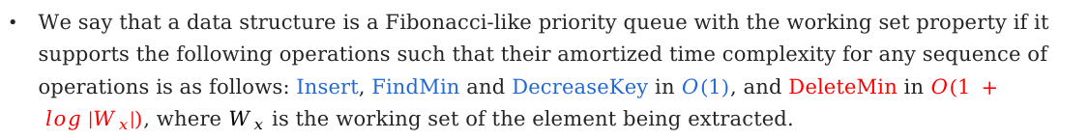
Overview
Definition (Fibonacci-like priority queue with the working set property)
We say that a data structure is a Fibonacci-like priority queue with the working set property if it supports the following operations such that their amortized time complexity for any sequence of operations is as follows: Insert, FindMin and DecreaseKey in $O(1)$, and DeleteMin in $O(1 + log |W_{x}|)$, where $W_{x}$ is the working set of the element being extracted.
Haeupler, Bernhard, et al. "Universal Optimality of Dijkstra via Beyond-Worst-Case Heaps." arxiv preprint arxiv:2311.11793.
4

Slide 6
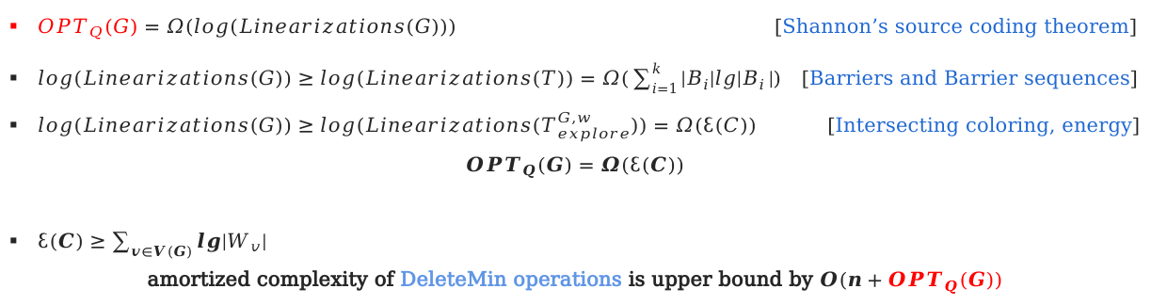
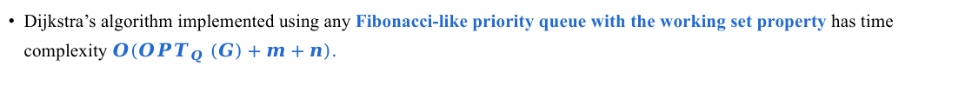
Overview
Theorem 3.1
Dijkstra’s algorithm implemented using any Fibonacci-like priority queue with the working set property has time complexity $O({OPT}_{Q} (G)+m+n).$
data structure
Sketch of Proof
${OPT}_{Q}(G)=Ω(log(Linearizations(G)))$ [Shannon’s source coding theorem]
$log(Linearizations(G))≥log(Linearizations(T))=Ω(\sum_{i=1}^{k}{|B_{i}|lg|B_{i}}|)$ [Barriers and Barrier sequences]
$log(Linearizations(G))≥log(Linearizations(T_{explore}^{G,w}))=Ω(ℇ(C))$ [Intersecting coloring, energy]
$${OPT}_{Q}(G)=Ω(ℇ(C))$$
$ℇ(C)≥\sum_{v∈V(G)}{lg|W_{v}|}$
amortized complexity of DeleteMin operations is upper bound by $Ο(n+{OPT}_{Q}(G))$
Haeupler, Bernhard, et al. "Universal Optimality of Dijkstra via Beyond-Worst-Case Heaps." arxiv preprint arxiv:2311.11793.
5

Slide 7
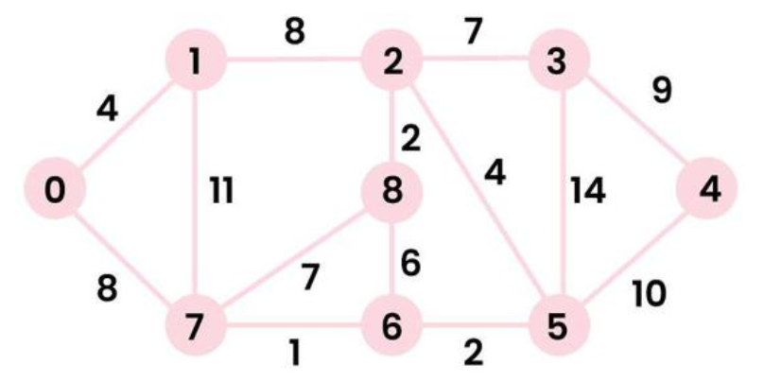
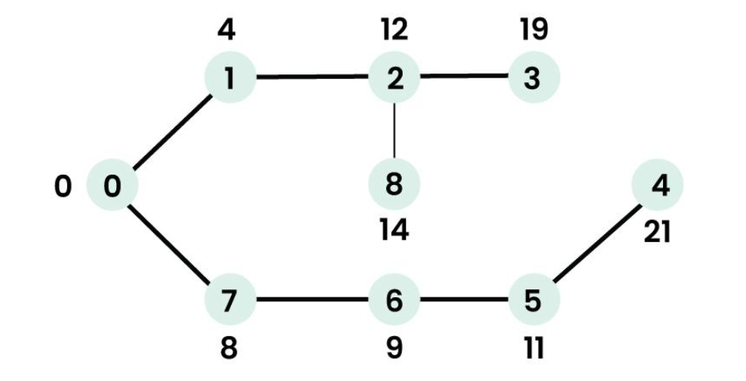
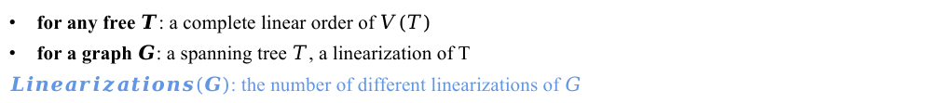
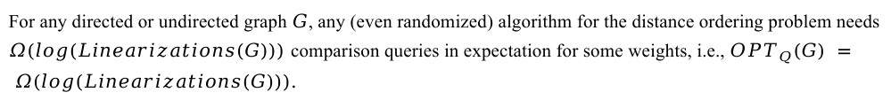
First lower bound
Lemma 3.3
For any directed or undirected graph $G$, any (even randomized) algorithm for the distance ordering problem needs $Ω(log⁡(Linearizations(G)))$comparison queries in expectation for some weights, i.e., ${OPT}_{Q}(G) = Ω(log⁡(Linearizations(G))).$
Definition: Linearization
for any free $T$: a complete linear order of $V(T)$
for a graph $G$: a spanning tree $T$, a linearization of T
$Linearizations(G)$: the number of different linearizations of $G$
Vertex | Distance from Source
0 | 0
1 | 4
7 | 8
6 | 9
5 | 11
2 | 12
8 | 14
3 | 19
4 | 21
https://www.geeksforgeeks.org/dijkstras-shortest-path-algorithm-greedy-algo-7/
6

Slide 8
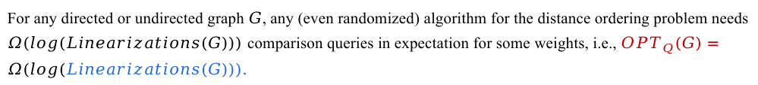
First lower bound
Lemma 3.3
For any directed or undirected graph $G$, any (even randomized) algorithm for the distance ordering problem needs $Ω(log⁡(Linearizations(G)))$comparison queries in expectation for some weights, i.e., ${OPT}_{Q}(G)=Ω(log⁡(Linearizations(G))).$
Single Source Shortest Path & Distance Ordering Problem
hypothesis space: $Linearizations(G)$
the execution of Dijkstra’s algorithm can be seen as a process of eliminating the false option.
Vertex | Distance from Source
0 | 0
1 | 4
7 | 8
6 | 9
5 | 11
2 | 12
8 | 14
3 | 19
4 | 21
https://www.geeksforgeeks.org/dijkstras-shortest-path-algorithm-greedy-algo-7/
7

Slide 9








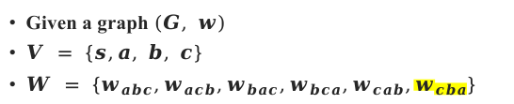





Entropy & Comparison Queries
Scenario
Given a graph $(G, w)$
$V = \{s,a, b, c\}$
$W = \{w_{abc},w_{acb},w_{bac},w_{bca},w_{cab},w_{cba}\}$
Comparison Query 1
Comparison Query 2
Comparison Query 3
$$a<b$$
1
0
$$w_{abc},w_{acb},w_{cab}$$
$$w_{bac},w_{bca},w_{cba}$$
$$a<c$$
$$a<c$$
1
0
1
0
$$w_{abc},w_{acb}$$
$$w_{cab}$$
$$w_{bac}$$
$$w_{bca},w_{cba}$$
$$b<c$$
10
01
$$b<c$$
1
0
1
0
$$w_{abc}$$
$$w_{acb}$$
$$w_{bca}$$
$$w_{cba}$$
111
110
001
000
Haeupler, Bernhard, et al. "Universal Optimality of Dijkstra via Beyond-Worst-Case Heaps." arxiv preprint arxiv:2311.11793.
8

Slide 10

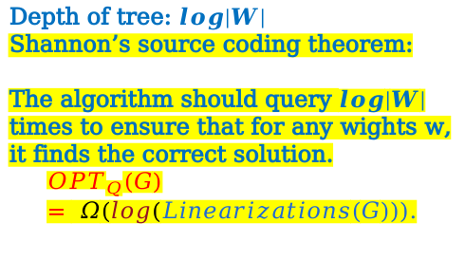
Entropy & Comparison Queries
Scenario
Depth of tree: $log|W|$
Shannon’s source coding theorem:
The algorithm should query $log|W|$ times to ensure that for any wights w, it finds the correct solution.
$${OPT}_{Q}(G) = Ω(log⁡(Linearizations(G))).$$
Given a graph $(G, w)$
$V = \{a, b, c\}$
$W = \{w_{abc},w_{acb},w_{bac},w_{bca},w_{cab},w_{cba}\}$
Comparison Query 1
Comparison Query 2
Comparison Query 3
$$a<b$$
1
0
$$w_{abc},w_{acb},w_{cab}$$
$$w_{bac},w_{bca},w_{cba}$$
$$a<c$$
$$a<c$$
1
0
1
0
$$w_{abc},w_{acb}$$
$$w_{cab}$$
$$w_{bac}$$
$$w_{bca},w_{cba}$$
00
$$b<c$$
10
01
$$b<c$$
1
0
1
0
$$w_{abc}$$
$$w_{acb}$$
$$w_{bca}$$
$$w_{cba}$$
111
110
001
000
Haeupler, Bernhard, et al. "Universal Optimality of Dijkstra via Beyond-Worst-Case Heaps." arxiv preprint arxiv:2311.11793.
9

Slide 11
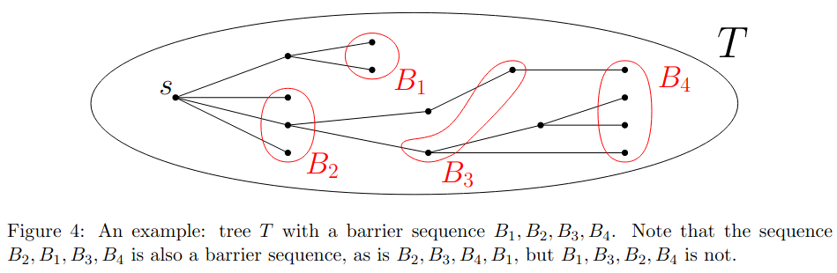
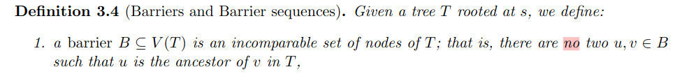
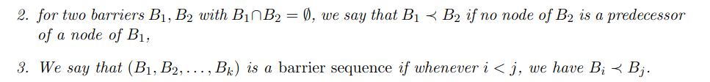
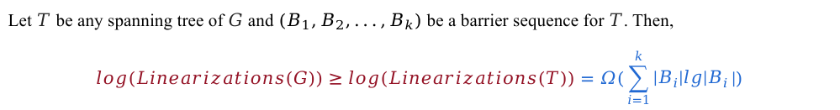
Second lower bound
Lemma 3.6 (Barriers give lower bounds)
Let $T$ be any spanning tree of $G$ and $(B_{1},B_{2},...,B_{k})$ be a barrier sequence for $T$. Then,
$$log(Linearizations(G))≥log(Linearizations(T))=Ω(\sum_{i=1}^{k}{|B_{i}|lg|B_{i}}|)$$
finding a good barrier sequence:
The global order can be determined by establishing order in several localities.
Dijkstra’s algorithm works in that way.
finding a good barrier sequence & finding a good interval coloring
https://www.geeksforgeeks.org/dijkstras-shortest-path-algorithm-greedy-algo-7/
10

Slide 12
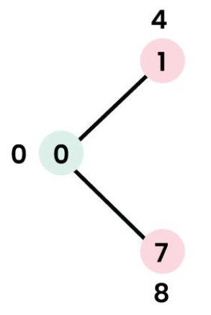
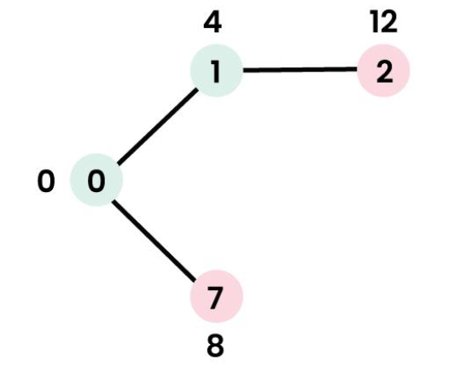
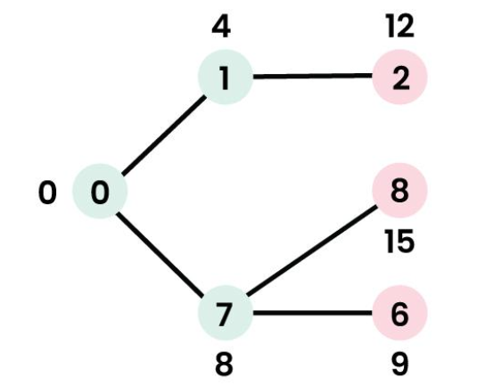
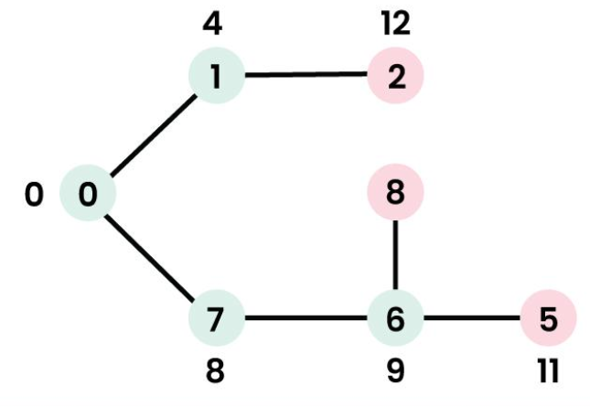
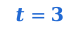

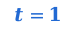
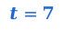

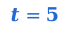

Explore Tree & Barrier
$$t=1$$
$$t=2$$
$$t=3$$
1
2
3
1
2
3
0
8
4
0
8
4
7
6
5
7
6
5
$$t=7$$
$$t=6$$
$$t=5$$
$$t=4$$
https://www.geeksforgeeks.org/dijkstras-shortest-path-algorithm-greedy-algo-7/
11

Slide 13
coloring
$$t=1$$
$$t=2$$
$$t=3$$
1
2
3
1
2
3
0
8
4
0
8
4
7
6
5
7
6
5
$$t=7$$
$$t=6$$
$$t=5$$
$$t=4$$
https://www.geeksforgeeks.org/dijkstras-shortest-path-algorithm-greedy-algo-7/
12

Slide 14
coloring
$$t=1$$
$$t=2$$
$$t=3$$
1
2
3
1
2
3
0
8
4
0
8
4
7
6
5
7
6
5
$$t=7$$
$$t=6$$
$$t=5$$
$$t=4$$
https://www.geeksforgeeks.org/dijkstras-shortest-path-algorithm-greedy-algo-7/
13

Slide 15
coloring
$$t=1$$
$$t=2$$
$$t=3$$
1
2
3
1
2
3
0
8
4
0
8
4
7
6
5
7
6
5
$$t=7$$
$$t=6$$
$$t=5$$
$$t=4$$
https://www.geeksforgeeks.org/dijkstras-shortest-path-algorithm-greedy-algo-7/
14

Slide 16
coloring
$$t=1$$
$$t=2$$
$$t=3$$
1
2
3
1
2
3
0
8
4
0
8
4
7
6
5
7
6
5
$$t=7$$
$$t=6$$
$$t=5$$
$$t=4$$
https://www.geeksforgeeks.org/dijkstras-shortest-path-algorithm-greedy-algo-7/
15

Slide 17
coloring
$$t=1$$
$$t=2$$
$$t=3$$
1
2
3
1
2
3
0
8
4
0
8
4
7
6
5
7
6
5
$$t=7$$
$$t=6$$
$$t=5$$
$$t=4$$
$B_{i}≤S,S$ is the set of nodes that are in the priority queue of the algorithm at time $t$
{0, 1, 7, 6, 5, 2, 8, 3, 4}
https://www.geeksforgeeks.org/dijkstras-shortest-path-algorithm-greedy-algo-7/
16

Slide 18
coloring
$$t=1$$
$$t=2$$
$$t=3$$
1
2
3
1
2
3
0
8
4
0
8
4
7
6
5
7
6
5
$$t=7$$
$$t=6$$
$$t=5$$
$$t=4$$
Lemma 3.11(Intersecting coloring gives a lower bound)
$$log(Linearizations(G))≥log(Linearizations(T_{explore}^{G,w}))=Ω(\sum_{i=1}^{k}{|B_{i}|lg|B_{i}}|)$$
https://www.geeksforgeeks.org/dijkstras-shortest-path-algorithm-greedy-algo-7/
17

Slide 19
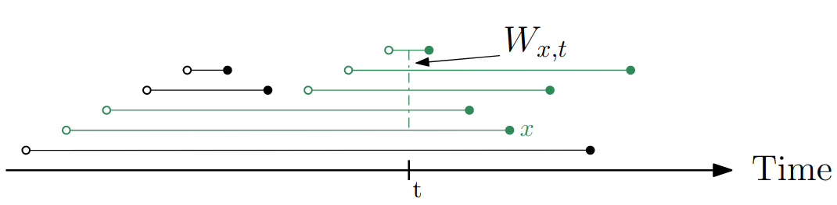
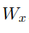
Working Set
1
2
3
1
2
3
0
8
4
0
8
4
7
6
5
7
6
5
$$t=4$$
$$t=5$$
$$t=6$$
$$t=2$$
$$t=3$$
Fig 6. An illustration of the working set property.
Haeupler, Bernhard, et al. "Universal Optimality of Dijkstra via Beyond-Worst-Case Heaps." arxiv preprint arxiv:2311.11793.
18

Slide 20
Fibonacci-like priority queue with the working set property
Definition (Fibonacci-like priority queue with the working set property)
We say that a data structure is a Fibonacci-like priority queue with the working set property if it supports the following operations such that their amortized time complexity for any sequence of operations is as follows: Insert, FindMin and DecreaseKey in $O(1)$, and DeleteMin in $O(1 + log |W_{x}|)$, where $W_{x}$ is the working set of the element being extracted.
Fig 6. An illustration of the working set property.
Haeupler, Bernhard, et al. "Universal Optimality of Dijkstra via Beyond-Worst-Case Heaps." arxiv preprint arxiv:2311.11793.
19

Slide 21


Proof
Lemma 3.12 (Finding a good coloring proves optimality)
$$\sum_{v in V(G)}{O(1+log|W_{v}|)=O(n +\sum_{v in V(G)}{log|W_{v}|)}= O(n + \sum_{i=1}^{k}{|B_{i}|lg|B_{i}}|)}$$
Lemma 3.6 (Barriers give lower bounds)
Let $T$ be any spanning tree of $G$ and $(B_{1},B_{2},...,B_{k})$ be a barrier sequence for $T$. Then,
$$log(Linearizations(G))≥log(Linearizations(T))=Ω(\sum_{i=1}^{k}{|B_{i}|lg|B_{i}}|)$$
Lemma 3.3
For any directed or undirected graph $G$, any (even randomized) algorithm for the distance ordering problem needs $Ω(log⁡(Linearizations(G)))$comparison queries in expectation for some weights, i.e., ${OPT}_{Q}(G)=Ω(log⁡(Linearizations(G))).$
Put together, the overall amortized complexity of DeleteMin operations is upper bounded by $O(n+OPTQ(G))$, as needed.
Haeupler, Bernhard, et al. "Universal Optimality of Dijkstra via Beyond-Worst-Case Heaps." arxiv preprint arxiv:2311.11793.
20

Slide 22
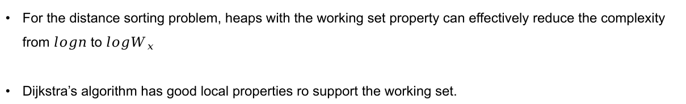
Conclusion
For the distance sorting problem, heaps with the working set property can effectively reduce the complexity from $logn$ to $logW_{x}$
Dijkstra’s algorithm has good local properties ro support the working set.
21

Slide 23
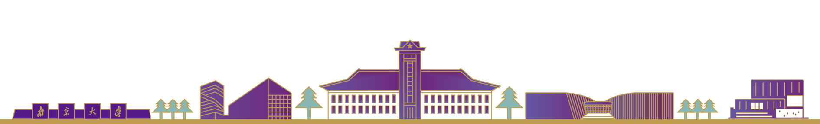

Thanks
Criticize & Correct

